Slide 1
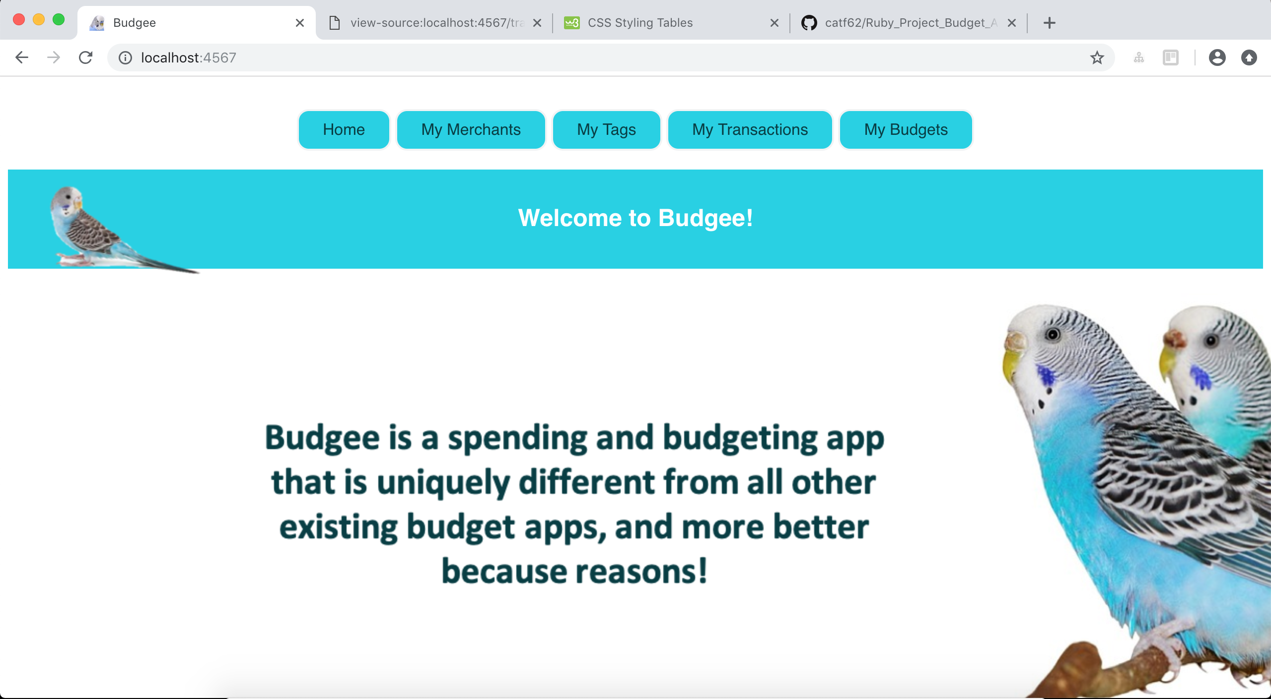
CodeClan Weeks 4 and 5
Ruby Project – Budgee App

Slide 2
Structure
Web App Tour
My approach
What I’d like to add
What I learned

Slide 3
Budgee Tour

Slide 4
Wireframes
My Approach – The Grand Plan
Plan Tables
Function Rationale
Plan Classes
CRUD Back-end
RESTful Routs Front-end
CSS
Web App!

Slide 5
Wireframes
My Approach – What Actually Happened

Slide 6
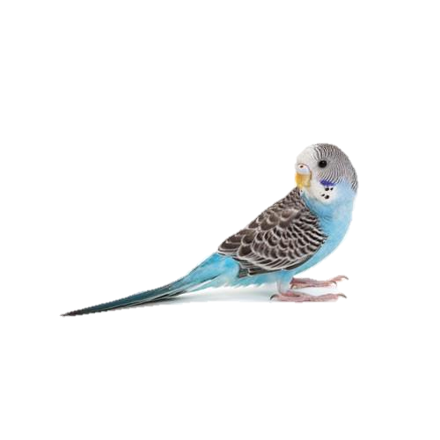
My Transactions – Table – Buttons - Fields
Home
My Spending
My Merchants
My Buy Tags
New Transaction
Edit Transactions
Budgee
My Transactions
Blah blah info about this page blah blah blah
My Budget: £500
Amount (£) | Merchant | Buy Tag | Essential? | Time | Day | Month | Total Spend (£) | Budget Remaining (£)
5.00 | Lidl | Groceries | Y | 16:00 | 28th | February | 5.00 | 495.00
60.00 | Sainsburys | Groceries | Y | 10:00 | 1st | March | 65.00 | 435.00
100.00 | Schuh | Clothes | N | 15:20 | 2nd | March | 165.00 | 335.00
35.00 | New Look | Clothes | Y | 16:00 | 2nd | March | 200.00 | 300.00
4.00 | Asda | Entertainment | N | 18:05 | 2nd | March | 204.00 | 296.00
19.99 | Zara | Clothing | N | 12:04 | 3rd | March | 223.99 | 276.01
Filter by Merchant
dropdown
Filter by Buy Tag
dropdown
Filter by Month
dropdown
Set my Budget (£)
text

Slide 7
My Merchants – Table – Buttons - Fields
Home
My Spending
My Merchants
My Buy Tags
New Transaction
Edit Transactions
Budgee
My Merchants
Blah blah info about this page blah blah blah
Existing Merchants
Lidl
Sainsburys
Schuh
New Look
Asda
Zara
Add Merchant
text
Edit Merchant
dropdown
text
Delete Merchant
dropdown

Slide 8
My Buy Tags – Table – Buttons - Fields
Home
My Spending
My Merchants
My Buy Tags
New Transaction
Edit Transactions
Budgee
My Buy Tags
Blah blah info about this page blah blah blah
Existing Buy Tags
Groceries
Clothes
Entertainment
Transport
Add Merchant
text
Edit Buy Tag
dropdown
text
Delete Merchant
dropdown

Slide 9
New Transaction - Form
Home
My Spending
My Merchants
My Buy Tags
New Transaction
Edit Transactions
Budgee
New Transaction
Blah blah info about this page blah blah blah
Amount
text
Merchant
dropdown
Buy Tag
dropdown
Essential?
Dropdown Y/N
Add New Transaction

Slide 10
Edit/Delete Transaction - Display
Home
My Spending
My Merchants
My Buy Tags
New Transaction
Edit Transactions
Budgee
Edit or Delete Transactions
Select a transaction to edit or delete by clicking on a row:
Amount (£) | Merchant | Buy Tag | Essential? | Time | Day | Month | Total Spend (£) | Budget Remaining (£)
5.00 | Lidl | Groceries | Y | 16:00 | 28th | February | 5.00 | 495.00
60.00 | Sainsburys | Groceries | Y | 10:00 | 1st | March | 65.00 | 435.00
100.00 | Schuh | Clothes | N | 15:20 | 2nd | March | 165.00 | 335.00
35.00 | New Look | Clothes | Y | 16:00 | 2nd | March | 200.00 | 300.00
4.00 | Asda | Entertainment | N | 18:05 | 2nd | March | 204.00 | 296.00
19.99 | Zara | Clothing | N | 12:04 | 3rd | March | 223.99 | 276.01

Slide 11
Edit/Delete Transaction - Form
Home
My Spending
My Merchants
My Buy Tags
New Transaction
Edit Transactions
Budgee
Edit or Delete Transactions
Amount (£) | Merchant | Buy Tag | Essential? | Time | Day | Month | Total Spend (£) | Budget Remaining (£)
100.00 | Schuh | Clothes | N | 15:20 | 2nd | March | 165.00 | 335.00
Amount
text
Amount
text
Merchant
dropdown
Merchant
dropdown
Buy Tag
date
Buy Tag
date
Essential?
Dropdown Y/N
Essential?
Dropdown Y/N
Date
Date
dropdown
Time
dropdown
Time
Day
Day
dropdown
dropdown
dropdown
Month
dropdown
Month
Edit This Transaction
Delete This
Transaction

Slide 12
Wireframes
My Approach – What Actually Happened
Plan Tables

Slide 13
Tables
Transactions
Id | Amount(£) (NUMERIC) | Merchant_id | Tag_id | Essential? (VARCHAR) | Time_added (NUMERIC) | Total spend(£) (NUMERIC) | Remaining Budget(£) (NUMERIC)
1 | 5.00 | 1 | 1 | Y | 16:00 | 5.00 | 495.00
2 | 10.00 | 1 | 2 | N | 17:15 | 15.00 | 480.00
3 | 19.99 | 2 | 1 | N | 10:00 | 34.99 | 445.01

Slide 14
Tables
Merchants
Id | Merchant Name (VARCHAR)
1 | Sainsburys
2 | Asda
3 | Zara
Tags
Id | Tag Name (VARCHAR)
1 | Groceries
2 | Travel
3 | Clothing
Transactions
Id | Amount(£) (NUMERIC) | Merchant_id | Tag_id | Essential? (VARCHAR) | Time_added (NUMERIC) | Total spend(£) (NUMERIC) | Remaining Budget(£) (NUMERIC)
1 | 5.00 | 1 | 1 | Y | 16:00 | 5.00 | 495.00
2 | 10.00 | 1 | 2 | N | 17:15 | 15.00 | 480.00
3 | 19.99 | 2 | 1 | N | 10:00 | 34.99 | 445.01

Slide 15
Tables
Merchants
Id | Merchant Name (VARCHAR)
1 | Sainsburys
2 | Asda
3 | Zara
Tags
Id | Tag Name (VARCHAR)
1 | Groceries
2 | Travel
3 | Clothing
Budgets
Id | Budget name (VARCHAR) | Budget Amount (£) (NUMERIC) | Start Time (DATETIME) | End Time (DATETIME)
1 | May 2018 | 500 | 03.41 AM Thursday, 03 May, 2018 | 03.41 AM Thursday, 30 May,
Transactions
Id | Amount(£) (NUMERIC) | Merchant_id | Tag_id | Essential? (VARCHAR) | Time_added (NUMERIC) | Total spend(£) (NUMERIC) | Remaining Budget(£) (NUMERIC)
1 | 5.00 | 1 | 1 | Y | 16:00 | 5.00 | 495.00
2 | 10.00 | 1 | 2 | N | 17:15 | 15.00 | 480.00
3 | 19.99 | 2 | 1 | N | 10:00 | 34.99 | 445.01

Slide 16
Tables
Budget_transactions
Id | Transaction id | Budget id | Remaining_budget(£) (NUMERIC)
1 | 1 | 1 | 495.00
2 | 2 | 1 | 485.00
Merchants
Id | Merchant Name (VARCHAR)
1 | Sainsburys
2 | Asda
3 | Zara
Tags
Id | Tag Name (VARCHAR)
1 | Groceries
2 | Travel
3 | Clothing
Budgets
Id | Budget name (VARCHAR) | Budget Amount (£) (NUMERIC) | Start Time (DATETIME) | End Time (DATETIME)
1 | May 2018 | 500 | 03.41 AM Thursday, 03 May, 2018 | 03.41 AM Thursday, 30 May,
Transactions
Id | Amount(£) (NUMERIC) | Merchant_id | Tag_id | Essential? (VARCHAR) | Time_added (NUMERIC) | Total spend(£) (NUMERIC) | Remaining Budget(£) (NUMERIC)
1 | 5.00 | 1 | 1 | Y | 16:00 | 5.00 | 495.00
2 | 10.00 | 1 | 2 | N | 17:15 | 15.00 | 480.00
3 | 19.99 | 2 | 1 | N | 10:00 | 34.99 | 445.01

Slide 17
Table Dependencies
Merchants
Tags
Transactions
Budgets
Budget_transactions

Slide 18
Wireframes
My Approach – What Actually Happened
Plan Tables
Confusion
Function Rationale

Slide 19
Function rationale – Page 1 - Merchants
Class | Function Name | Why? | How? | Returning
Merchant | .save C | New merchants need to be added to database | Insert a new merchant with a name into the merchants table | Database assigns id and returns it
Merchant | Self.find R | Merchants will need to be found and selected to Identify merchants to be edited Filter displayed table by merchants | Takes in an id and searches the merchants table for all merchants with that id | The first matching merchant
Merchant | Self.all R | My Merchants page will need to show a list of all existing merchants | Selects all merchants in merchants table | Full list of merchants in merchants table
Merchant | Self.map_items | Needed for the self.all function to work | News up new merchant objects into a hash | Hash of new merchant objects called merchant_data
Merchant | .update U | User need to be able to change and update merchants | The name of an existing merchant is changed in Ruby using @merchant.merchant_name, then the update function is called on that merchant to change it in the database | No specified output, but the alteration should appear in the database

Slide 20
Function rationale – Page 2 – Merchants/Budgets
Class | Function Name | Why? | How? | Returning
Merchant | Delete by id D | Users will need to have the ability to delete existing merchants | By selecting the entry with a specific id in the merchants table and deleting it | The merchant just deleted, not need to display this
Merchant | Delete all D | It might be useful for users to be able to delete all their existing merchants | By selecting everything in the merchants table and deleting it | No ?
Tag and Budget classes need all the same functions as Merchant class for the same reasons.
Class | Function Name | Why? | How? | Returning
Budget | Budget Remaining | Users will need to see how much is left in the budget after each transaction | Select all transaction id’s Budget_amount

Slide 21
Wireframes
My Approach – What Actually Happened
Plan Tables
Confusion
Function Rationale
Plan Classes

Slide 22
Classes
Merchant
@id @merchant_name(Str)
Initialize Save (to database) Self find Self all Self map items delete
Tags
@id @tag_name(Str)
Initialize Save (to database) Self find Self all Self map items delete
Transaction
@id @amount(numeric) @merchant_id @tag_id @essential(Str) @time_added(TIMESTAMP) @total_spent(numeric) total spend can be calculated in the html and shouldn’t be a column in the database
Initialize Get time/date now Calculate total spent Save (to database) Self find Self all Self map items delete
Budget
@id @budget_name(Str) @budget_amount(numeric) @start_time(TIMESTAMP) @end_time @remaining_budget(numeric) remaining budget can be calculated in the html and shouldn’t be a column in the database
Initialize Save (to database) Self find Self all Self map items delete

Slide 23
Classes
Budget_transactions
@id @transaction_id @budget_id
Initialize Save (to database) Self find Self all Self map items delete

Slide 24
Wireframes
My Approach – What Actually Happened
Plan Tables
Confusion
Function Rationale
Plan Classes
CRUD Back-end

Slide 25
Wireframes
My Approach – What Actually Happened
Plan Tables
Confusion
Function Rationale
Plan Classes
Bugs
CRUD Back-end

Slide 26
Wireframes
My Approach – What Actually Happened
Plan Tables
Confusion
Function Rationale
Plan Classes
Bugs
CRUD Back-end
Not asking for help

Slide 27
Wireframes
My Approach – What Actually Happened
Plan Tables
Confusion
Function Rationale
Plan Classes
Bugs
CRUD Back-end
Not asking for help
The same bugs for longer
Frustration!

Slide 28
Wireframes
My Approach – What Actually Happened
Plan Tables
Confusion
Function Rationale
Plan Classes
Bugs
CRUD Back-end
Not asking for help
The same bugs for longer
Solving bugs
Asking for help
Frustration!

Slide 29
Wireframes
My Approach – What Actually Happened
Plan Tables
Confusion
Function Rationale
Plan Classes
Bugs
CRUD Back-end
Not asking for help
The same bugs for longer
Solving bugs
RESTful Routs Front-end
Asking for help
Frustration!

Slide 30
Wireframes
My Approach – What Actually Happened
Plan Tables
Confusion
Function Rationale
Plan Classes
Bugs
More Bugs
CRUD Back-end
Not asking for help
The same bugs for longer
Solving bugs
RESTful Routs Front-end
Asking for help
Frustration!

Slide 31
Wireframes
My Approach – What Actually Happened
Plan Tables
Confusion
Continued bug struggles
Function Rationale
Still not asking for help
Plan Classes
Bugs
More Bugs
CRUD Back-end
Not asking for help
The same bugs for longer
Solving bugs
RESTful Routs Front-end
Asking for help
Frustration!

Slide 32
Wireframes
My Approach – What Actually Happened
Plan Tables
Confusion
Continued bug struggles
Function Rationale
Still not asking for help
Asking for help
Plan Classes
Bugs
More Bugs
Solving bugs
CRUD Back-end
Not asking for help
The same bugs for longer
Solving bugs
RESTful Routs Front-end
Asking for help
Frustration!

Slide 33
Wireframes
My Approach – What Actually Happened
Plan Tables
Confusion
Continued bug struggles
Function Rationale
Still not asking for help
Asking for help
Plan Classes
Bugs
More Bugs
Solving bugs
CRUD Back-end
Not asking for help
The same bugs for longer
Solving bugs
RESTful Routs Front-end
Asking for help
Frustration!
CSS

Slide 34
Wireframes
My Approach – What Actually Happened
Plan Tables
Confusion
Continued bug struggles
Function Rationale
Still not asking for help
Asking for help
Plan Classes
Bugs
More Bugs
Solving bugs
CRUD Back-end
Not asking for help
The same bugs for longer
Solving bugs
RESTful Routs Front-end
Asking for help
Frustration!
CSS

Slide 35
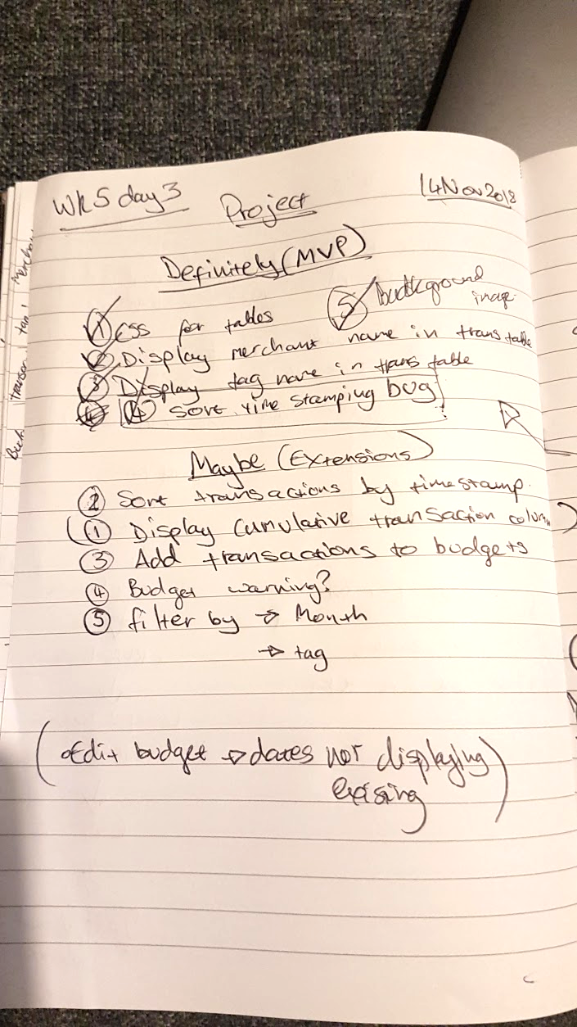
Yesterday Afternoon

Slide 36
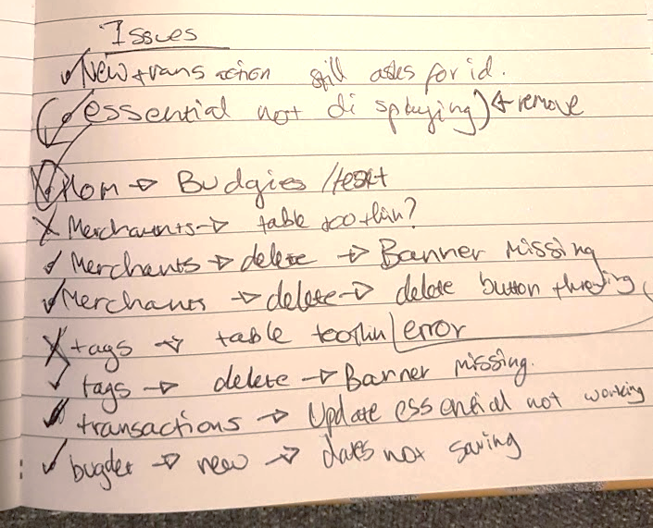
Yesterday Afternoon

Slide 37
Wireframes
My Approach – What Actually Happened
Plan Tables
Confusion
Continued bug struggles
Function Rationale
Still not asking for help
Asking for help
Plan Classes
Bugs
More Bugs
Solving bugs
CRUD Back-end
Not asking for help
The same bugs for longer
Solving bugs
RESTful Routs Front-end
Asking for help
Frustration!
Panic Bug Fixing!
CSS

Slide 38
Wireframes
My Approach – What Actually Happened
Plan Tables
Confusion
Continued bug struggles
Function Rationale
Still not asking for help
Asking for help
Plan Classes
Bugs
More Bugs
Solving bugs
CRUD Back-end
Not asking for help
The same bugs for longer
Solving bugs
RESTful Routs Front-end
Asking for help
Frustration!
Panic Bug Fixing!
CSS
Asking for help
Solving bugs
Web App!

Slide 39
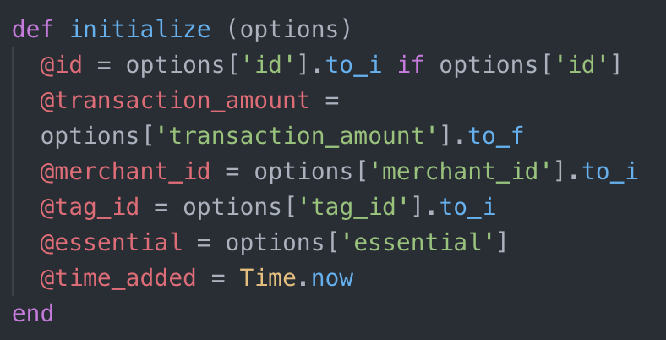
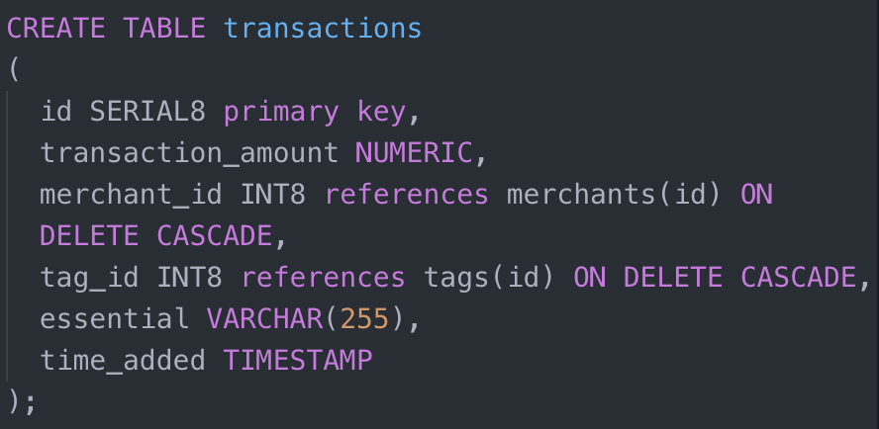
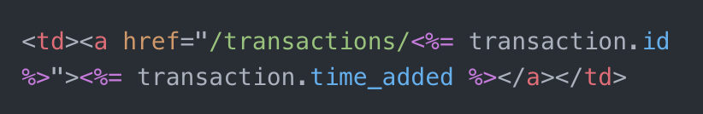
Capturing Time Bug
transaction.rb Model
budget_app.sql
index.erb/transactions View

Slide 40
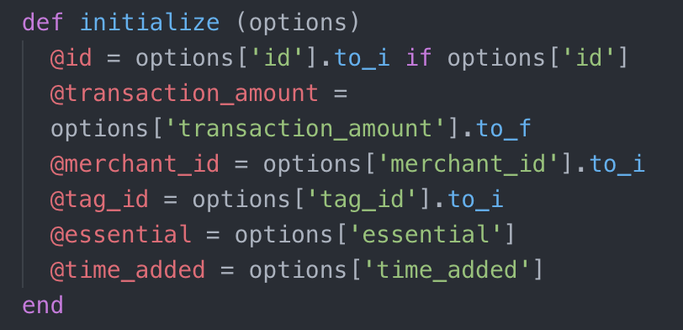
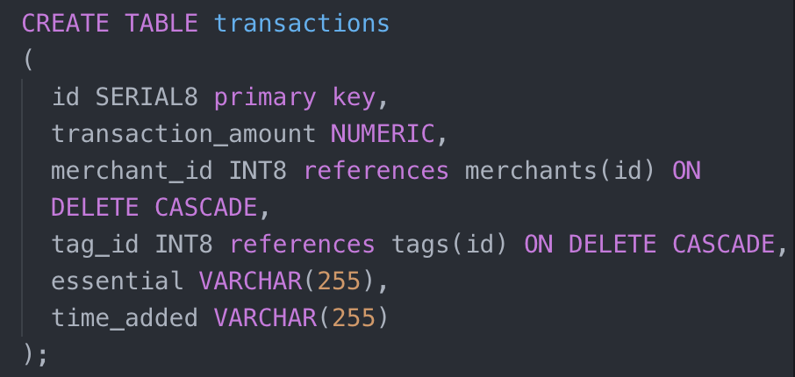
Capturing Time Bug
transaction.rb Model
budget_app.sql
index.erb/transactions View

Slide 41
What I’d like to add to the app:
Ability to add transactions to budgets
Ability to sort/filter transactions by
Merchant name
Tag name
Date
Essential
Alarm message when the user is getting close to the budget limit
Total up transactions (back-end already written for this!)

Slide 42

What I’ve learned
Asking for help can save MASSES of time
Taking regular breaks massively improves my productivity
Staring at code doesn’t solve bugs
Reading error messages works
Following code back through it’s path works
I don’t regret making back-end that didn’t get used
Easier to implement if I come back to it
I think I like CSS
Some Ruby? Some SQL? Maybe?

